Slide 1
Computer Lab
Jessica Randall, MPH

Slide 2
Recap
Last class:
Coding HW 2
This class:
Coding HW 3
Next class:
Introduction to Bioconductor I

Slide 3
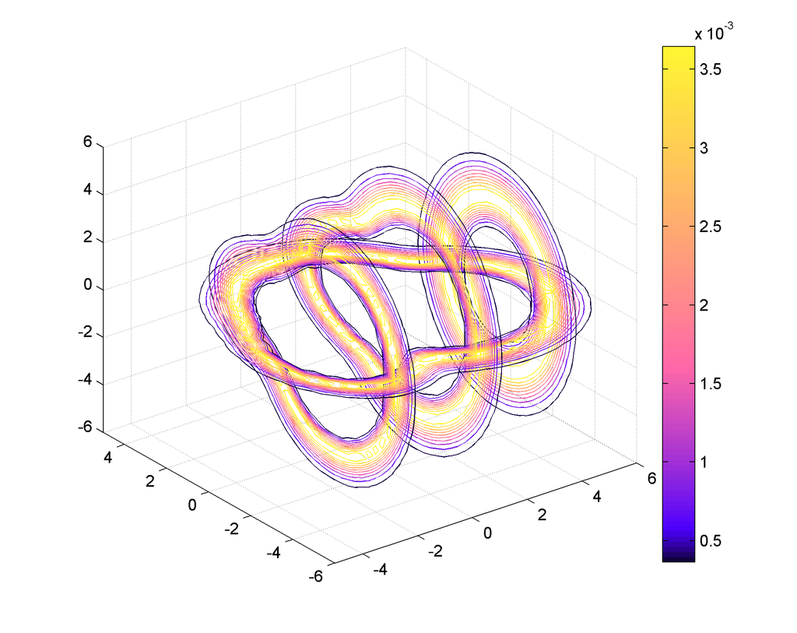
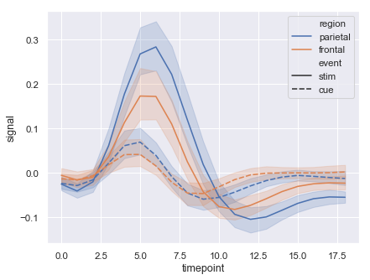
Seaborn
Michael Waskom, 2012
Built on top of simpler Matplotlib visualization library (based on Matlab)
Emphasis on being attractive and informational
Use the Anaconda distribution for data analysis and Jupyter Notebook for documentation

Slide 4
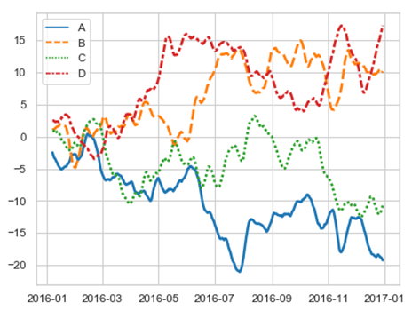
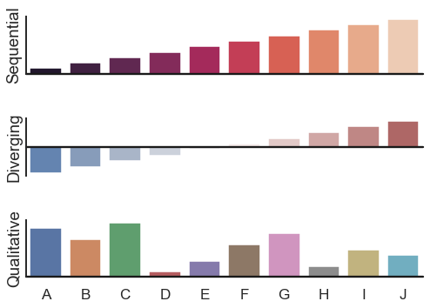
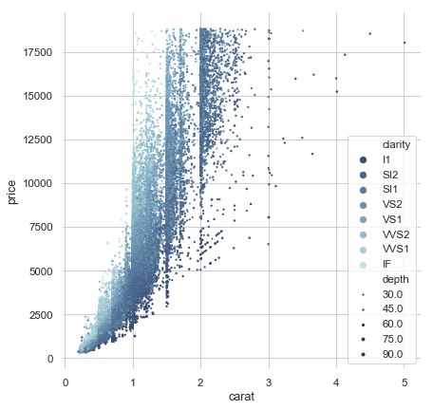
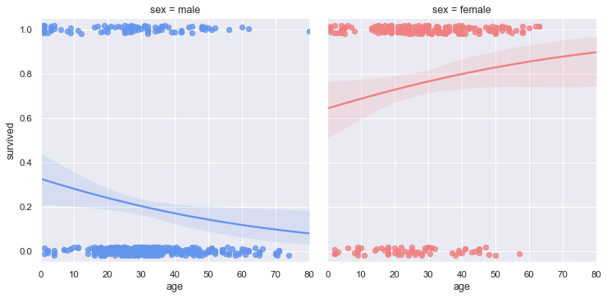
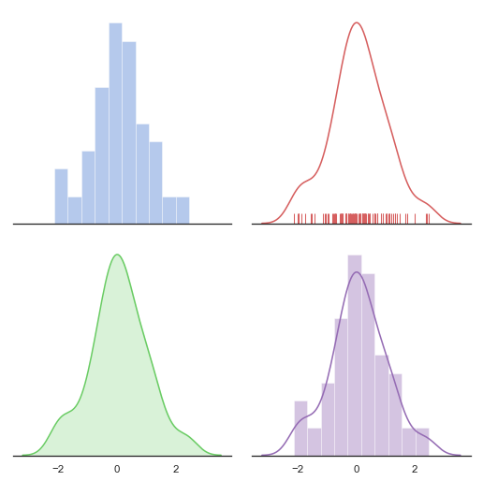
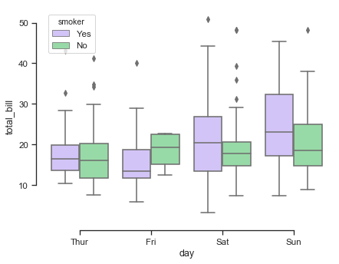
Examples
Line plot
Bar plot
Scatter plot
lm plot
Distribution plot
Box plot
Waksom, 2018b, 2018c, 2018d, 2018e

Slide 5
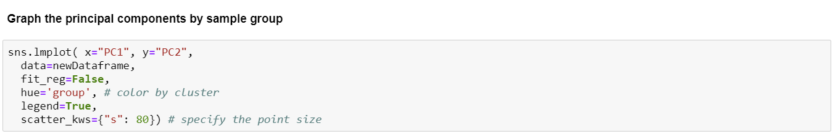
Walkthrough HW 3

Slide 6
Now you try
customize your graph using lmplot documentation or any other resources
Remember to include titles
work in pairs or groups
ask questions, we’ll be happy to help!

Slide 7
Resources & References
Waskom, M. (2018a). An introduction to seaborn — seaborn 0.9.0 documentation. Retrieved April 14, 2019, from https://seaborn.pydata.org/introduction.html
Waskom, M. (2018b). Distribution plot options — seaborn 0.9.0 documentation. Retrieved April 14, 2019, from https://seaborn.pydata.org/examples/distplot_options.html
Waskom, M. (2018c). Grouped barplots — seaborn 0.9.0 documentation. Retrieved April 14, 2019, from https://seaborn.pydata.org/examples/grouped_barplot.html
Waskom, M. (2018d). Lineplot from a wide-form dataset — seaborn 0.9.0 documentation. Retrieved April 14, 2019, from https://seaborn.pydata.org/examples/wide_data_lineplot.html
Waskom, M. (2018e). Scatterplot with categorical and numerical semantics — seaborn 0.9.0 documentation. Retrieved April 14, 2019, from https://seaborn.pydata.org/examples/different_scatter_variables.html
Waskom, M. (2018f). Timeseries plot with error bands — seaborn 0.9.0 documentation. Retrieved April 14, 2019, from https://seaborn.pydata.org/examples/errorband_lineplots.html

